Slide 1
Association Rule Mining
Lecture 10

Slide 2
Introduction
Association Rule Mining (also called as Association Rule Learning) is a common technique used to find associations between many variables (features) by looking at the transactions.
Examples:
Market Basket Analysis is a popular application of Association Rules.
People who visit webpage X are likely to visit webpage Y
People who have age-group [30,40] & income [>$100k] are likely to own home

Slide 3
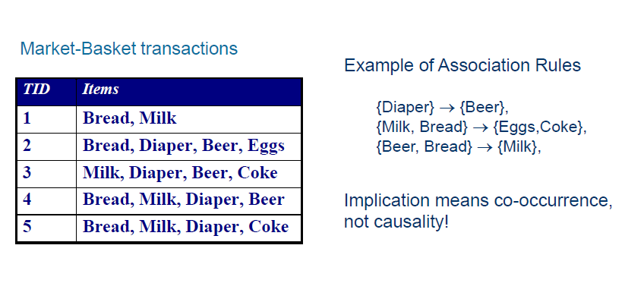
ARM for Market-Basket data
Given a set of transactions, find rules that will predict the occurrence of an item based on the occurrences of other items in the transaction

Slide 4
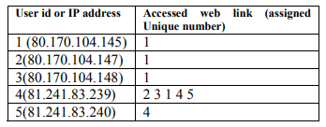
ARM for web usage data
Web usage log files generated on web servers contain huge amount of information that can be used for discovering web usage association rules (Kosala & Blockeel, 2000; Wang, Li, & Zhang, 2005)
Can be used for enhancing the effectiveness of websites through user personalization or developing directed web marketing campaigns

Slide 5
Measures of Effectiveness of the Rule
The measures of effectiveness of the rule are as Follows:
Support
Confidence
Lift
Others: Affinity, Leverage
We are going to discuss Support and Confidence in more detail using an example dataset.

Slide 6
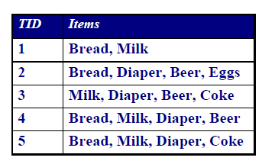
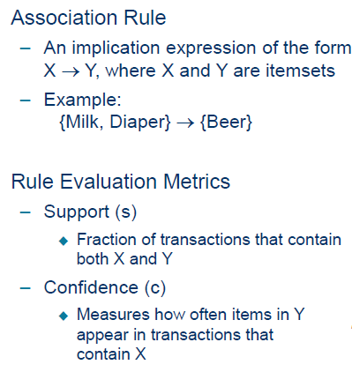
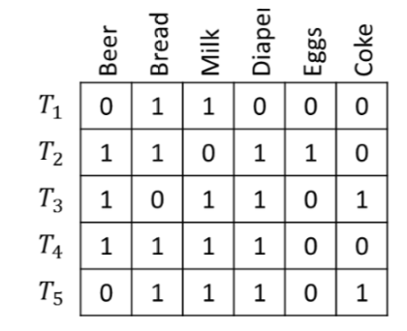
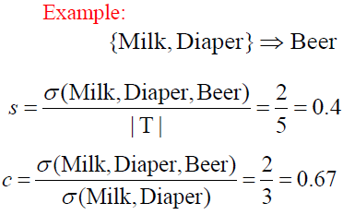
Definition: Association Rule

Slide 7
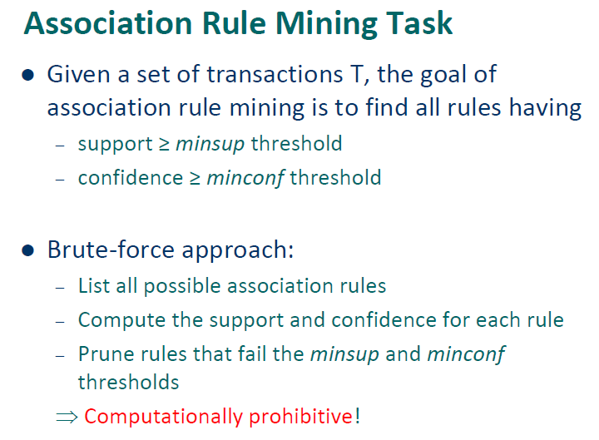

Slide 8
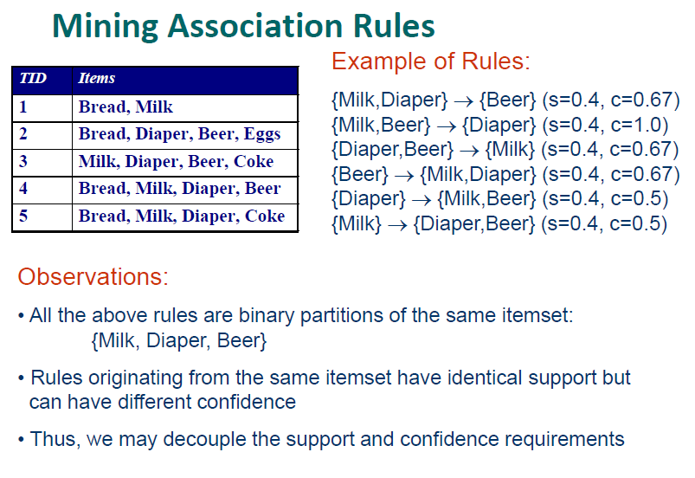

Slide 9
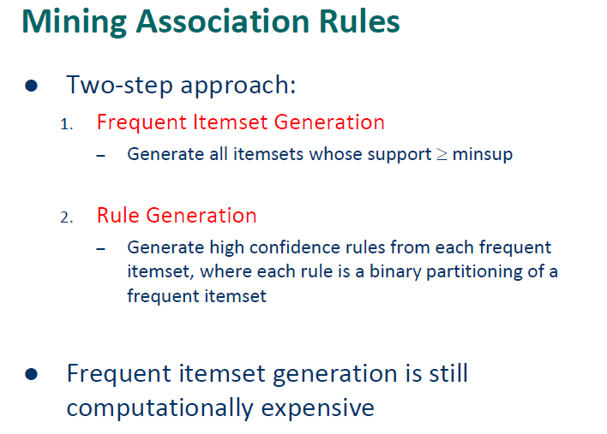

Slide 10
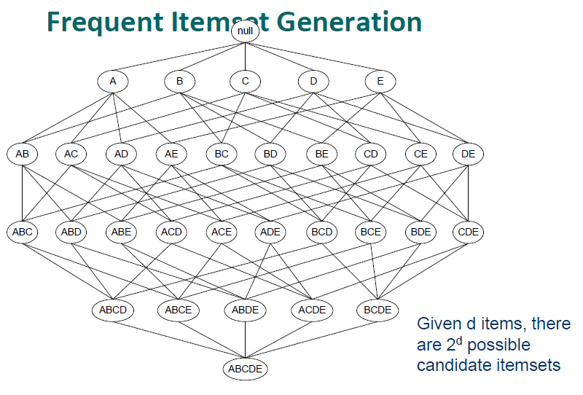

Slide 11
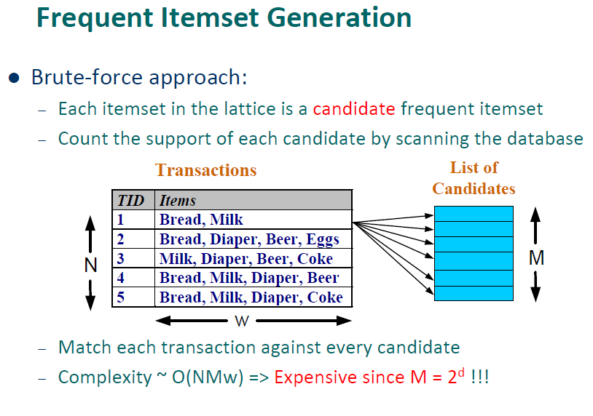

Slide 12
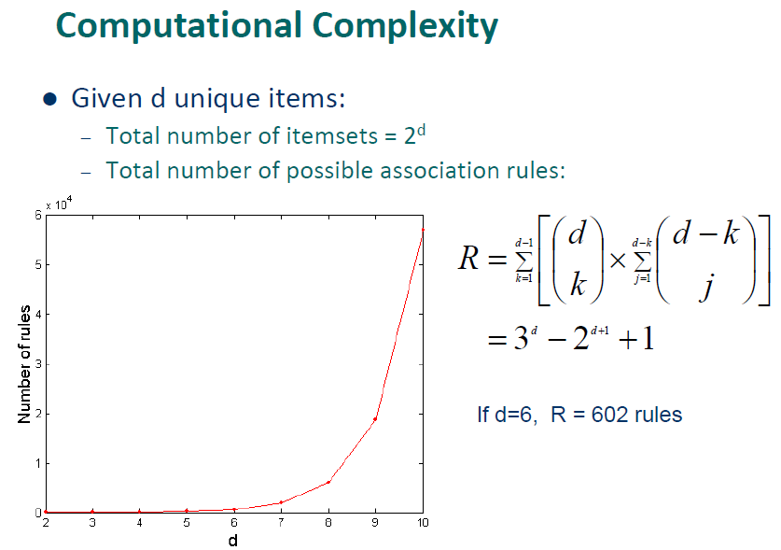

Slide 13
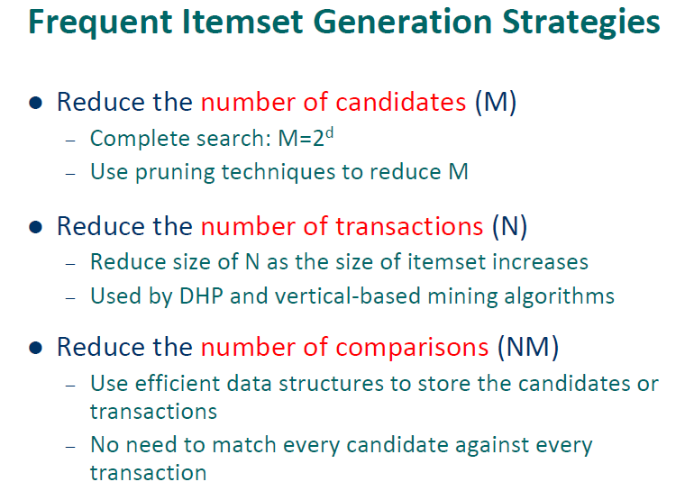

Slide 14
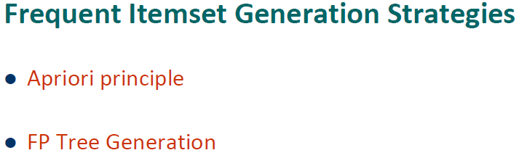

Slide 15
References
Lecture Notes for Chapter 6, Introduction to Data Mining, by Tan, Steinbach, Kumar

